Slide 1
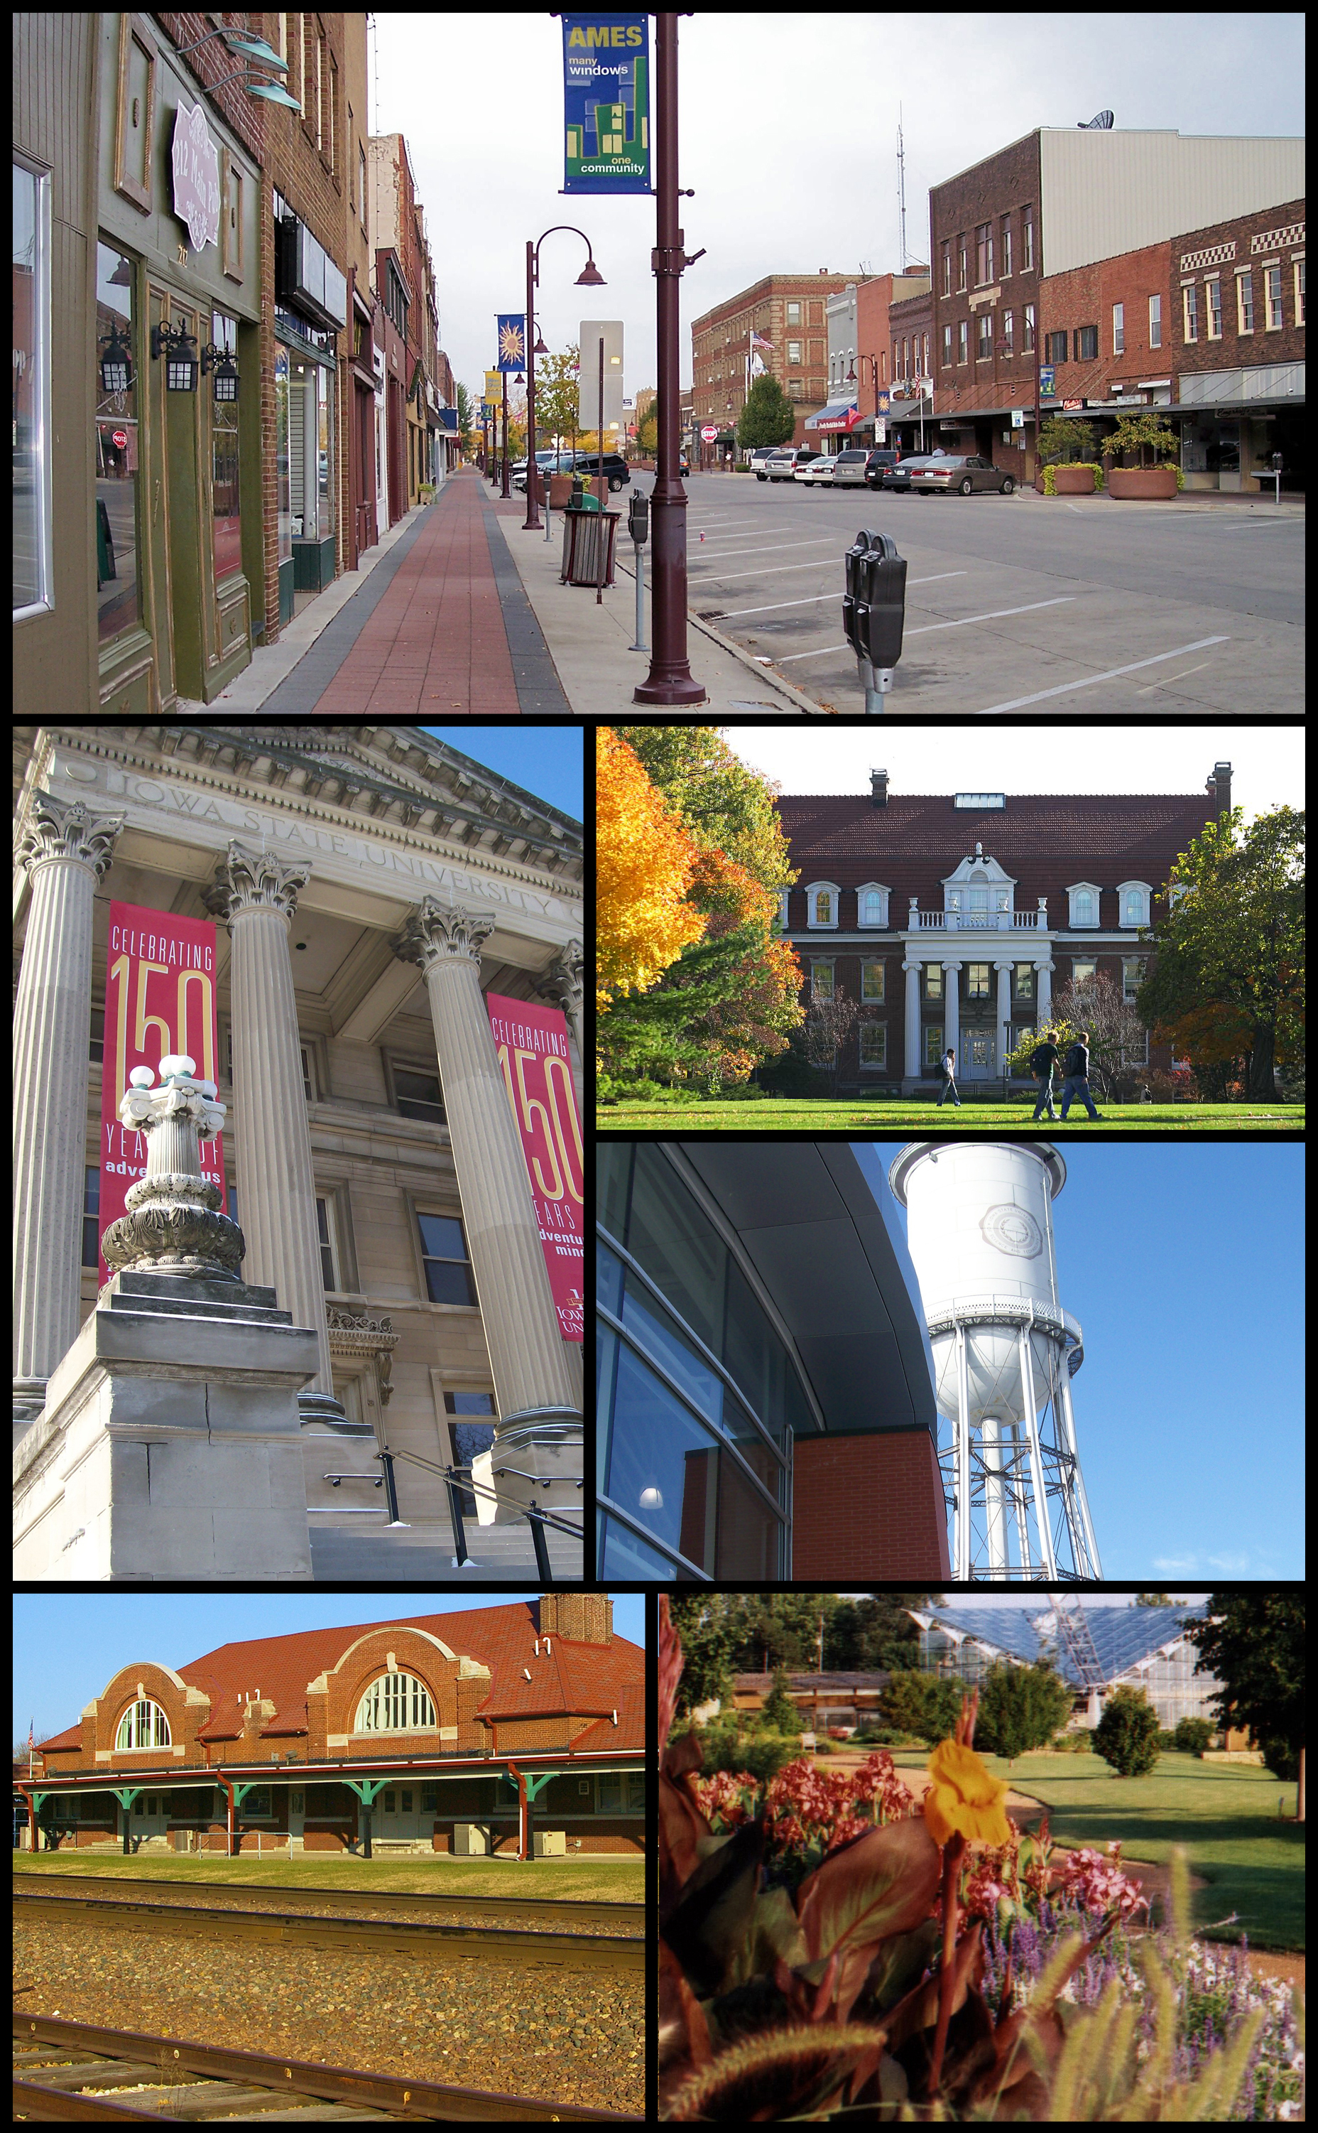
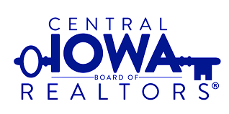
Improving Home Value with Data Science
Helping motivated sellers get top dollar for their Ames home
Notes:
Good afternoon, and welcome to the Central Iowa Board of Realtors quarterly meeting.
My name is Heather JOhansen, I'm a data scientist, and I'll be giving today's Keynote.
Today we are going to look at how data science can inform decisions on improving house value in Ames, Iowa.

Slide 2



Listing Agent Goals:
Sell your client’s home for the highest price
in the shortest amount of time,
with the least amount of work for the homeowner
However, sometimes staging isn’t enough…
Notes:
A Realtor’s, you may fill a variety of roles, including investing, flipping, buying and selling. A
Today, I want you put on your Listing Agent hat. As you know, in that role you have three big goals:
But we know that even if a homeowner if ready to sell, sometimes the house itself isn’t. We’re going to look at tangible ways you can help a homeowner increase the value of their house so they can get top dollar.

Slide 3
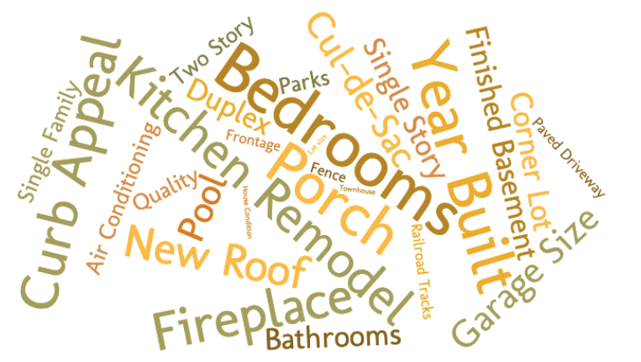
Where do you start?
Notes:
Realtor instincts are great and can provide your homeowner with excellent guidance. But none of us can be experts in every feature of a house or property. When faced with so many options, and a homeowner with limited time and money to spend, how do you point them in the right direction?

Slide 4
Data Science can help!
First, what is data science?
Data science uses existing or historical data
to create or predict new data
which we use to make decisions and take action.¹
How can it help us today?
¹ Definition sourced from https://www.innoarchitech.com/blog/what-is-data-science-does-data-scientist-do
Notes:
Ames assessors office has compiled an impressive number of statistics about roughly 3000 homes sold from 2006 to 2010. 80+ features in fact. I built a number of regression models that look for correlations between home and lot features and selling price. With a focus on two things: 1) High correlation between feature and price, and 2) Features that a homeowner can change about their home, and 3) High ability of the model to explain price variation. I built a model with 30 features. So let’s take a look.

Slide 5
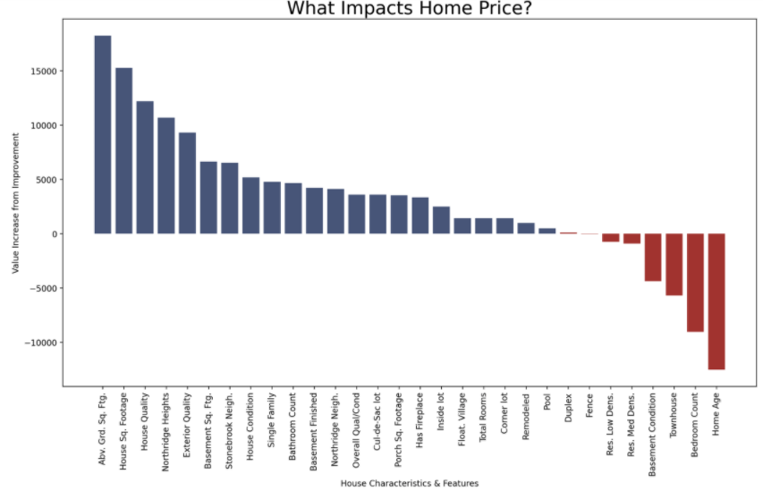
Top Drivers of Home Price
85% of the change in sale price for homes in Ames can be explained by these 30 characteristics.
As Realtors, knowing which of these areas can be improved, and whether they will materially impact value is a critical service to your clients.
Basement Attributes
Features and Quality
Home Type
Neighborhoods
Lot Configuration
Notes:
This chart shows those 30 features, and how impactful they are on selling price.
The model explains about 85% of the variation in selling price and includes these types of features:
Neighborhoods...
What we are going to look at how is 8 features and quality grades that a homeowner can actually impact.
As much as we'd all love to move a great house in Old Town up to Northridge or Stonebrook, that's just not feasible.

Slide 6
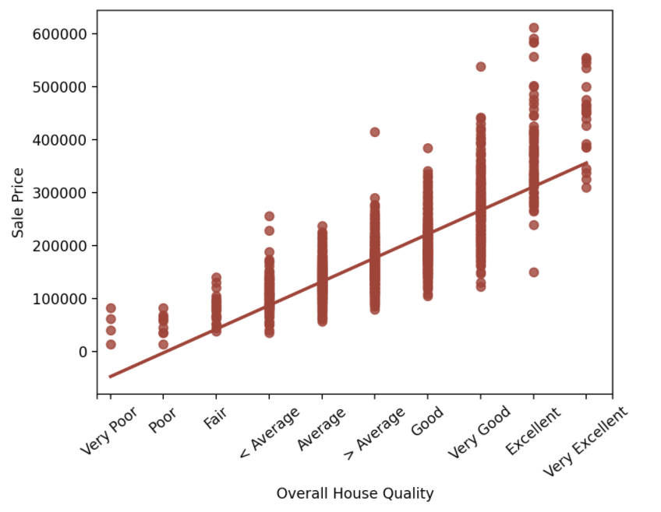
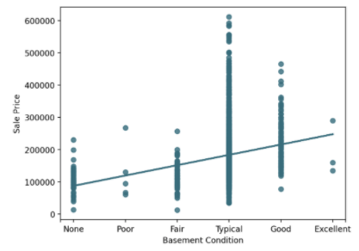

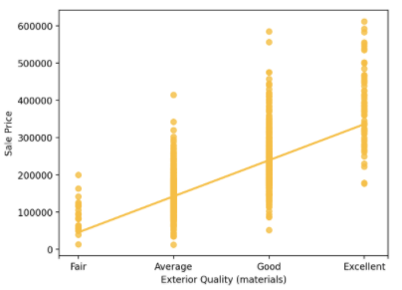
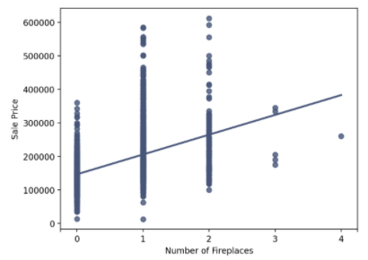
Primed for Improvements
$$$
$
$$
$
Notes:
First up is overall house quality. This is about the finishes and materials used in the house. Ames assessors office has ranked houses on a 10 points scale. In my model, this quality ranking had the highest correlation to sale price. Moving your home up the scale even 1 step can have a 4-digit increase in value.
Similarly, the exterior quality and materials of the house also have a large impact on price. This is about how the house contributes to curb appeal, something near and dear to any Realtor’s heart. Improvements here can also materially impact how much a homeowner can expect to get for their house.
Next up is Basement Condition. Poor basements here have a lot of cracking and moisture. Improving the condition of your basement, especially making it more water-tight, can help improve sellability.
Finally on this slide, the number of fireplaces in the home can help increase price. This may not seem like low hanging fruit at first, but if you had a fireplace in one room, opening up the wall behind the fireplace into the next room could be a relatively low-price remodel, which could be paid for in home value increase.

Slide 7
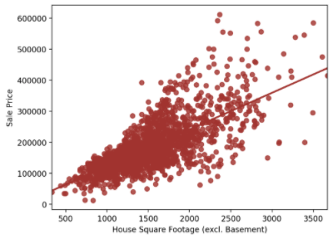
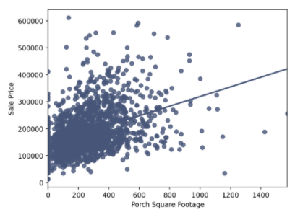
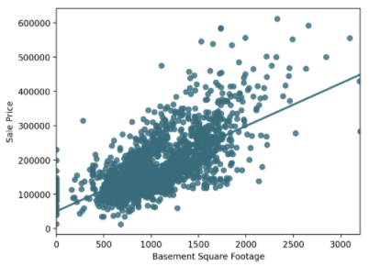
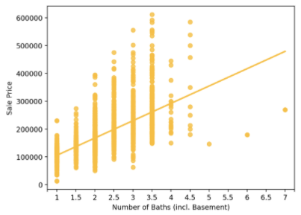
Bigger Improvements
$$$
$
$$
$
Notes:
Next up are some changes that might cost a bit more, but that should still be considered, especially for homeowners who are willing to put in some elbow grease themselves.
Above Gr. Home sq footage and basement sq. footage increases both have significant impact to house value.
Adding or improving a porch or deck can allow you to ask more for a home.
And even increasing the number of bathrooms. Again, this sounds costly, but this could be turning a half or ¾ bath into a full bath, and that will increase home value.

Slide 8
Conclusions
While some attributes about a client’s home can’t be easily changed, those that can be improved can significantly impact sale price.
Knowing opportunities for improvement, and directing motivated clients in that direction, can be a great differentiator for you as a Realtor.
Fixed Home Features | Opportunities to Improve
Neighborhood | Improve finishes and materials
House type/zone | Increase curb appeal
Lot type/shape | Increase square footage
Age of Home | Add bathrooms

